Slide 1
Yalla Go
Let’s play… let’s Go… let’s Discover and let’s make it fun and challenging to our visitors

Slide 2
How can we give our visitor an amazing experience?
How we can encourage our visitor to visit other places and to know more about them?
How can we make this visit fun and worth to share with the community and friends ?

Slide 3
Yalla GO

Slide 4
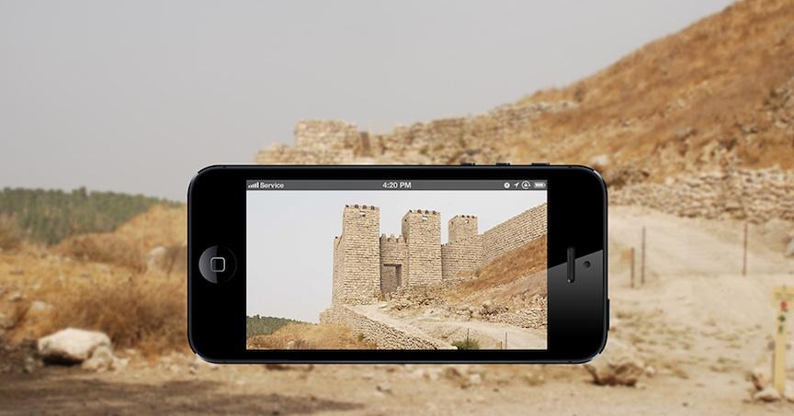
What is YallaGo.
It’s a game app built by using one of the most trending technology globally which it the Augmented reality, we’re going to use this technology to build a game promotes tourism places in a very smart, engaged, fun, challenging and cool way.

Slide 5
Key functions
Location
→ Notification about the closed famous places to visit.
→ If the visitor got succeeded in refer a place to his friends
and community he will get points.
Referral
AR Game
→ Gamify the tourism experience through adding a games
related to the place that the visitor is visiting
→ More engaging .
→ Encourage them to visit another near famous places .

Slide 6
Key functions
→Feature gives visitors ability to chat and meet people from the visited city .
Meet locals
Yalla guide
→to communicate with the tourism guides to help in this place and each one with a rate.
E-Store
→E-store to sell the tourist thing from people who are live in the country (Locals)

Slide 7
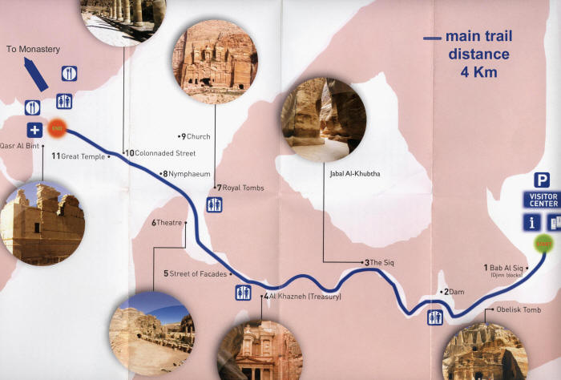
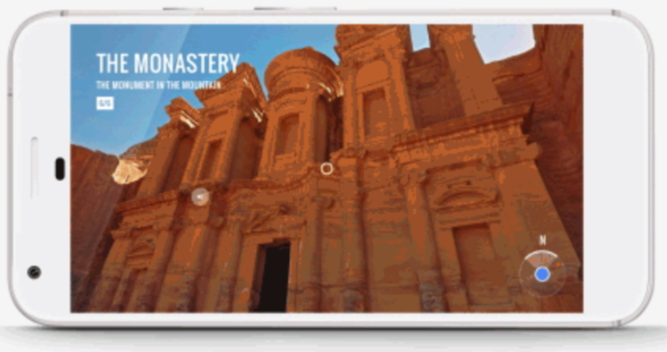
Example of a game story
A level of the Game

Slide 8
Yalla Business

Slide 9
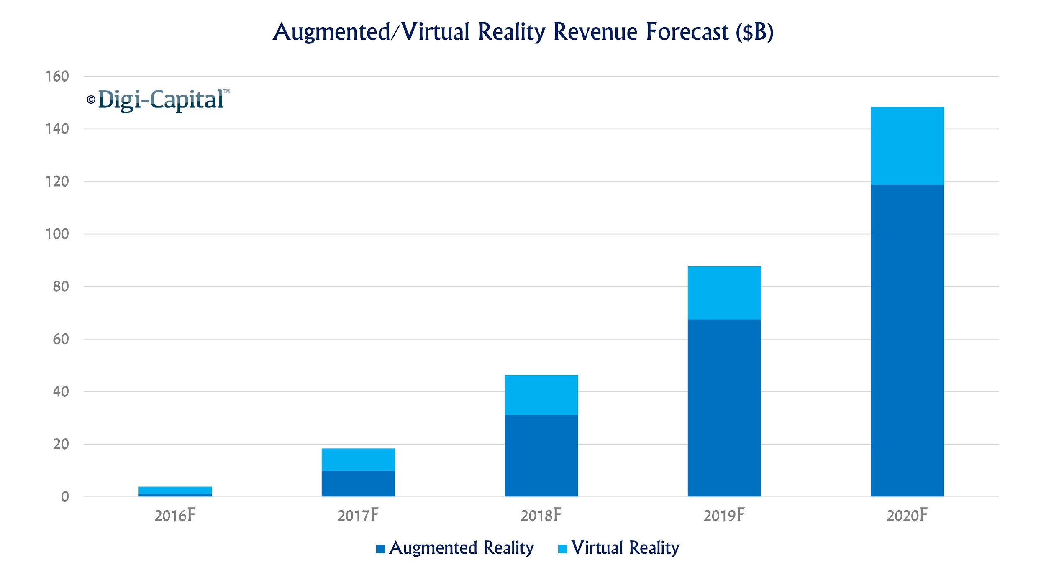
Where my market goes to?
This is why we believe that our solution is so strong

Slide 10
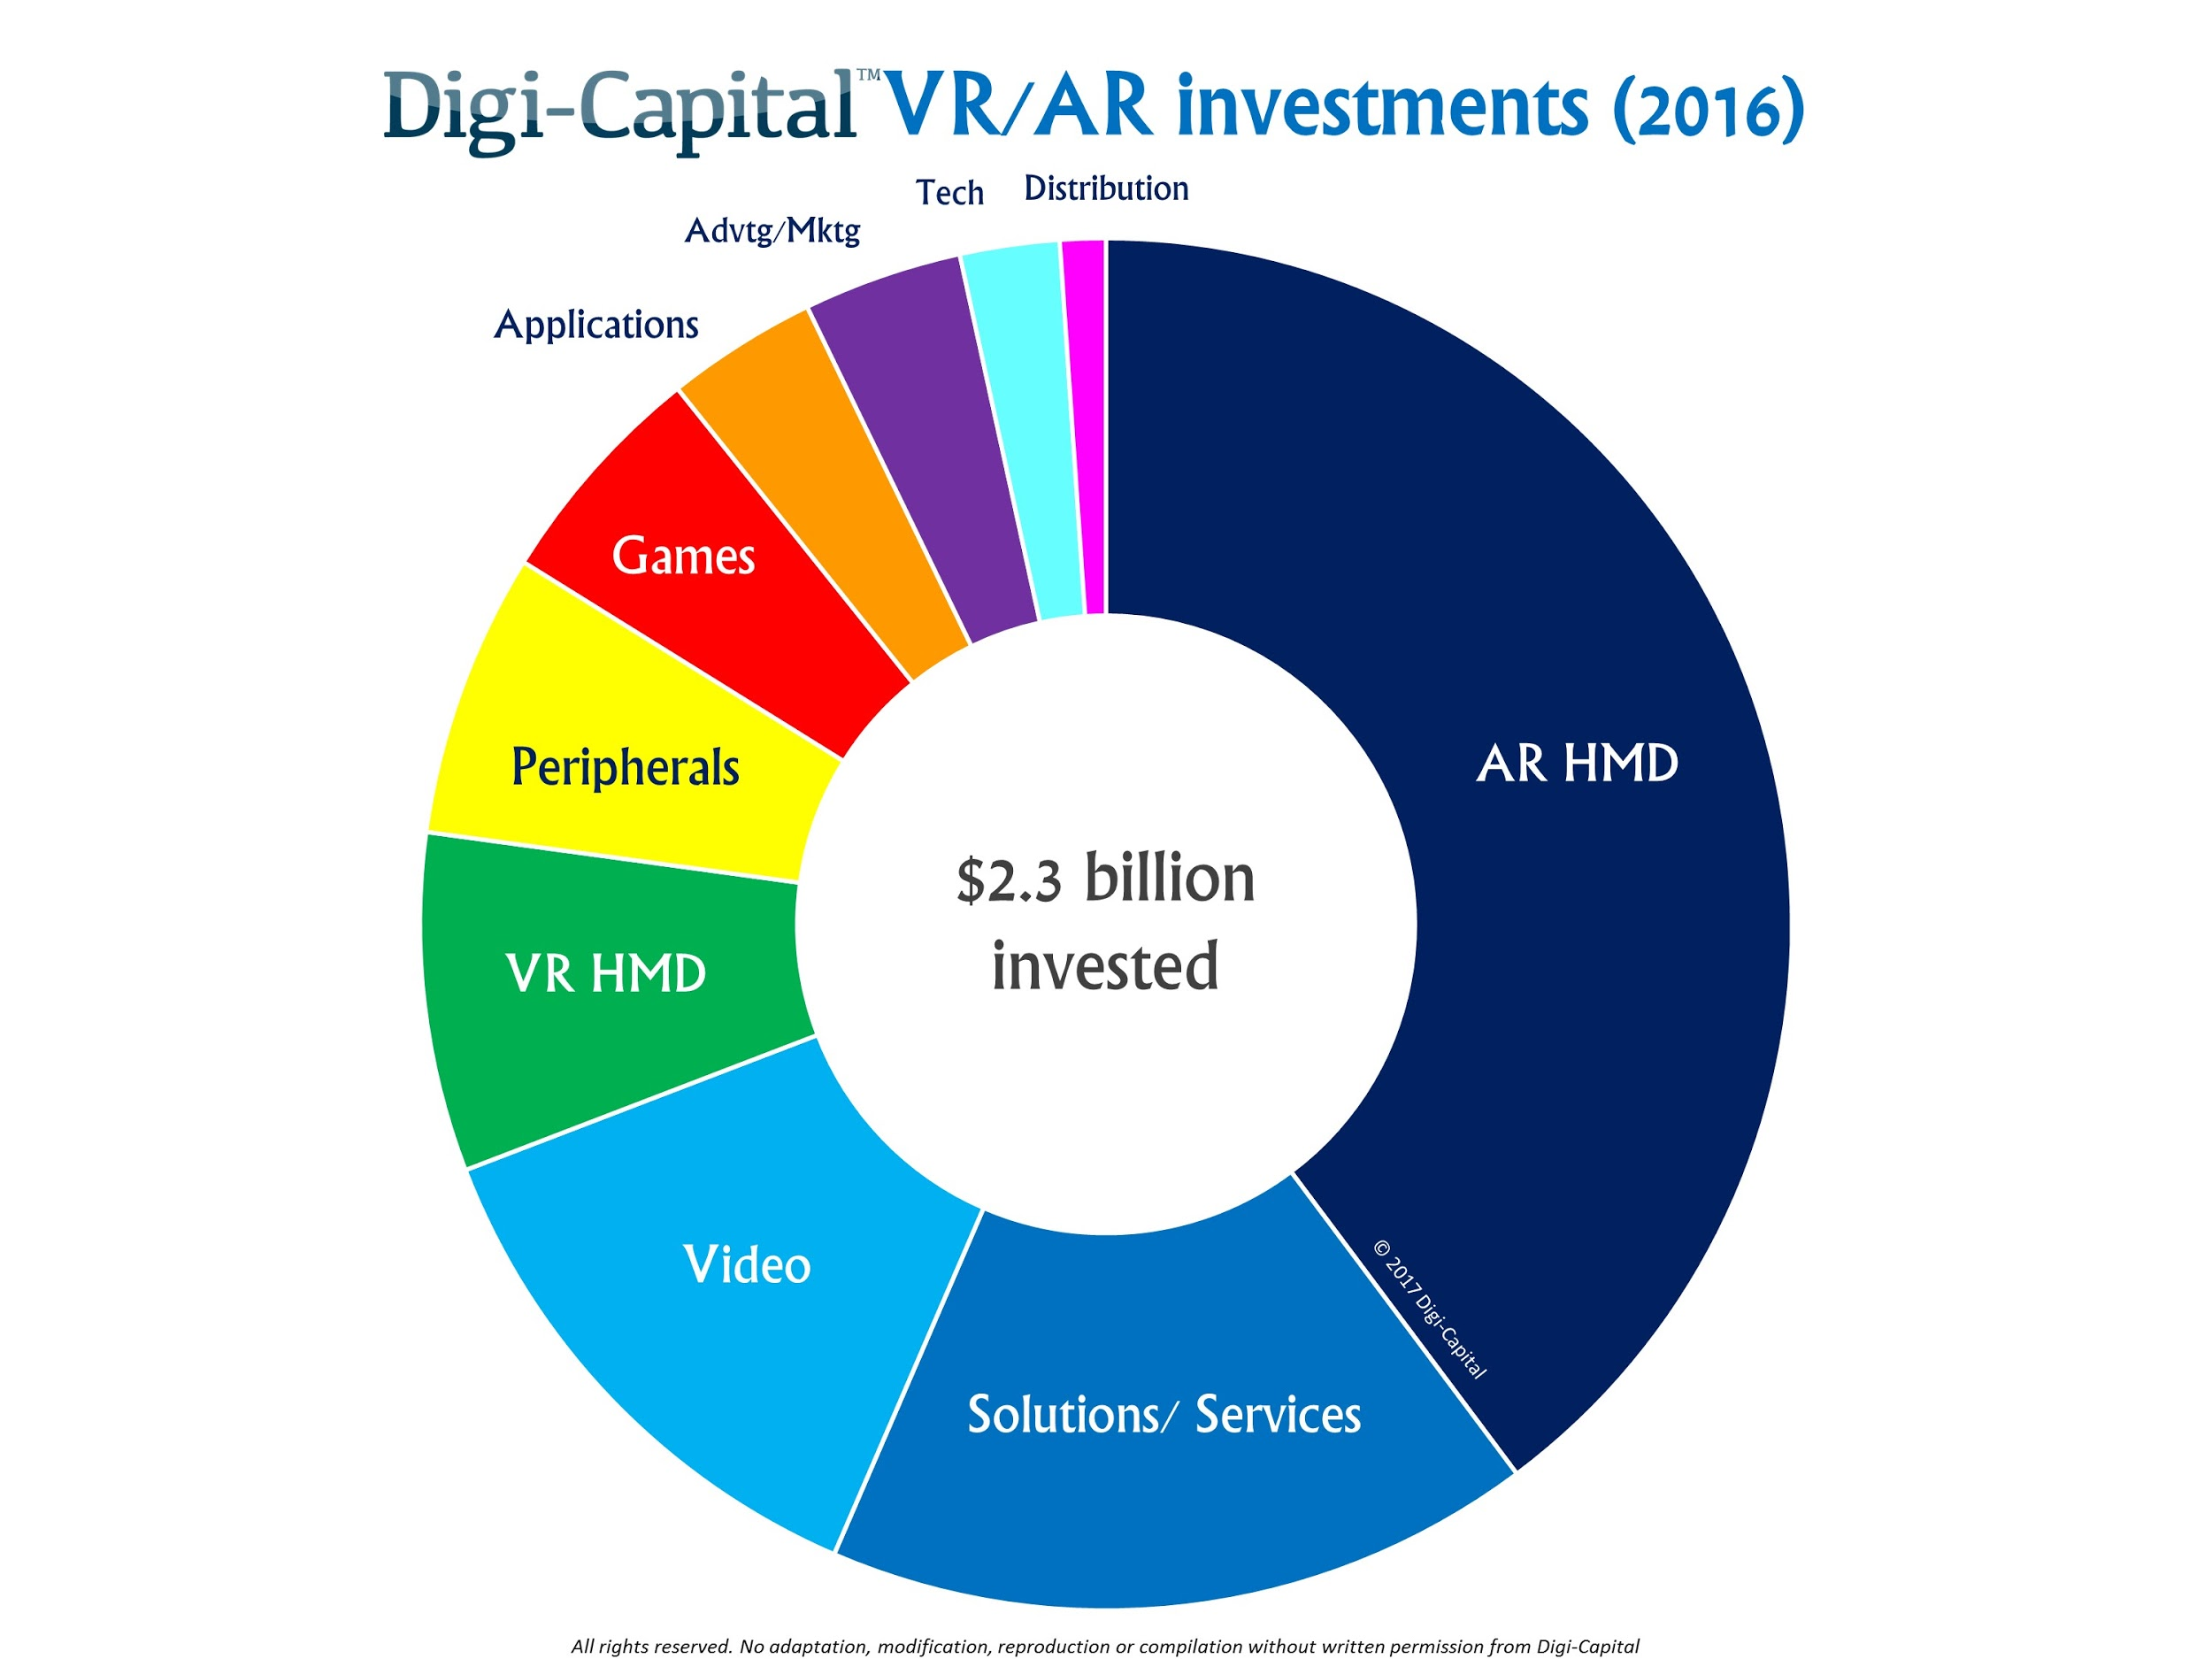
What about global investments?

Slide 11
Growth and scalability
Product for 3 areas
50,000
20,000
Product for 2 areas
5,000
10,000
Modified MVP for all one area
12-32 Months
6-12 Months
MVP in 3 places for one place
3 - 6 Months
3 - 6 Months
Languages : Arabic English
Marketing channels : Digital Marketing, Partners and telecommunications companies or even Game Invites(Affiliate)

Slide 12
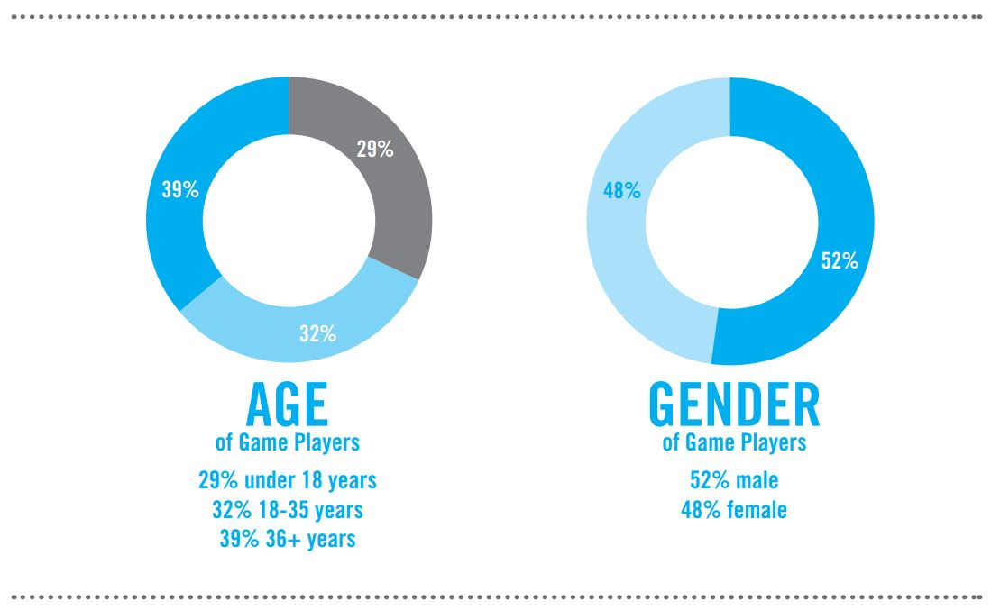
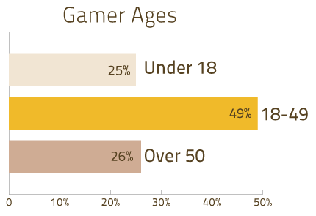
What about my targeted audience?
1- Male | 18 - 49
2- female | 18 - 49
VentureBeat-the ESA updates 2017
Notes:
يتوجب عليك في هذه الصفحة تناول نقطتين رئيسيتين:
ما هو الحجم الإجمالي للسوق الذي تسعى إلى جذبه من خلال الشركة أو
المنتج الذي تقدمه؟
على سبيل المثال، يبلغ السوق الإجمالي لشركة «Airbnb» 1.9 مليار دولار
أمريكي، وهي قيمة الرحلات المحجوزة من حول العالم
تتوفر المزيد من المعلومات على الرابط الإلكتروني:
https://lsvp.wordpress.com/2011/03/16/how-to-estimate-
market-size/
من هي فئة العملاء المستهدفة؟
ما هي الفئة التي تسعى إلى الوصول إليها؟ يمكنك أن تحددها بالعمر أو الجنس أو
الموقع أو مستوى الدخل أو الاهتمامات أو غيرها.
ما عدد العملاء التي تتمتع به الشركة بالصفات المذكورة أعلاه وما العدد الذي
يمكنك الوصول إليه؟
حدد المنطقة التي تعيش بها هذا الفئة من العملاء
ما هي القوة الشرائية التي تتمتع بها هذه الفئة؟

Slide 13
Revenue streams?
B2C
B2B
Through in app purchases like coins, tools, character enhancement and all these things.
Through selling our offline goods like our smart T-shirts.
Advertisements and Location sms.
Making their logo or location part of the story.
Brands solution and brands customization.
Partnership and WE WILL USE THE DATA to improve the experience

Slide 14
Yalla Go
Let’s play … Let’s Go

